Slide 1


Carbon Emissions Prediction
Om S. Naringe
Shrawani Bonde
Bhumika Bawane
Purvesh P. Savalakhe
Mentor Name: Saurabh Tembhurne
College Name - SIPNA College of Engineering and Technolog , Amravati
Notes:
Let's delve deeper into the exciting world of sustainability and AI.
In this chapter, we'll explore how artificial intelligence can be a powerful tool for addressing environmental challenges and promoting sustainable practices. We'll discuss specific applications of AI in various sectors and analyze its potential to drive positive change.
Get ready to discover the innovative ways AI is contributing to a more sustainable future!

Slide 2

Project Objectives
Problem Statement
Project Overview – Introduction
End Users
Wow Factor in Project
Modelling/Block Diagram/Flow of Project
Result/outcomes
Conclusion
Future Perspective
Notes:
Let's outline what you'll learn in this presentation.
By the end, you'll be able to:
Understand how AI helps solve problems like climate change, resource depletion, and biodiversity loss.
Identify key AI uses in energy efficiency, waste management, and climate change.
Analyze AI's role in sustainable agriculture and cities.
Evaluate AI's use in environmental monitoring using satellites, real-time data, and predictions.
Apply AI strategies in logistics and transportation to make them more sustainable.
Get ready to discover how AI can help create a greener future!

Slide 3
Problem Statement
Carbon emissions are a major driver of climate change. There is a need for accurate and timely prediction of emissions to help policymakers and industries plan for a sustainable future.
Notes:
Sustainability and AI
Sustainability is important because it helps meet our needs now and in the future. It includes protecting the environment, reducing pollution, and improving economic and social well-being.
AI can help us achieve sustainability. AI can process data, make predictions, and optimize systems to solve problems like resource management, environmental conservation, and energy efficiency.
Examples:
Smart grids: Reduce energy consumption.
Agriculture: Optimize water and fertilizer use.
Biodiversity: Monitor wildlife to protect biodiversity.
AI is a powerful tool for creating a more sustainable future.

Slide 4
Project Overview - Introduction
Carbon emissions are a leading cause of climate change and global warming.
Rapid growth in industries, energy consumption, and transportation has increased emission levels worldwide.
Predicting future emissions is vital for policy makers, researchers, and industries to design sustainable strategies.
Traditional estimation methods lack accuracy and adaptability to complex real-world data.
By applying data analytics and machine learning techniques, we can build models that forecast carbon emissions more reliably.
The project aims to provide data-driven insights to support sustainable development and climate action.
Notes:
Sustainability and AI
Sustainability is important because it helps meet our needs now and in the future. It includes protecting the environment, reducing pollution, and improving economic and social well-being.
AI can help us achieve sustainability. AI can process data, make predictions, and optimize systems to solve problems like resource management, environmental conservation, and energy efficiency.
Examples:
Smart grids: Reduce energy consumption.
Agriculture: Optimize water and fertilizer use.
Biodiversity: Monitor wildlife to protect biodiversity.
AI is a powerful tool for creating a more sustainable future.

Slide 5
End Users
Government & Policy Makers
To design and implement emission reduction policies.
Environmental Agencies & NGOs
For monitoring climate change and sustainability efforts.
Industries & Corporations
To track their carbon footprint and comply with regulations.
Urban Planners & Smart Cities
To plan eco-friendly infrastructure and reduce emissions.
General Public
To raise awareness and encourage sustainable practices
Notes:
Sustainability and AI
Sustainability is important because it helps meet our needs now and in the future. It includes protecting the environment, reducing pollution, and improving economic and social well-being.
AI can help us achieve sustainability. AI can process data, make predictions, and optimize systems to solve problems like resource management, environmental conservation, and energy efficiency.
Examples:
Smart grids: Reduce energy consumption.
Agriculture: Optimize water and fertilizer use.
Biodiversity: Monitor wildlife to protect biodiversity.
AI is a powerful tool for creating a more sustainable future.

Slide 6
Wow Factors in Project
• Data-Driven Insights – Uses machine learning to find hidden patterns
• High Accuracy Forecasting – Reliable predictions vs. traditional methods
• Real-World Impact – Helps reduce carbon footprint for governments & industries
• Scalability – Applicable across regions, sectors, and timelines
• Visualization & Reporting – Clear dashboards for decision-making
• Sustainability Contribution – Supports global climate goals
Notes:
Sustainability and AI
Sustainability is important because it helps meet our needs now and in the future. It includes protecting the environment, reducing pollution, and improving economic and social well-being.
AI can help us achieve sustainability. AI can process data, make predictions, and optimize systems to solve problems like resource management, environmental conservation, and energy efficiency.
Examples:
Smart grids: Reduce energy consumption.
Agriculture: Optimize water and fertilizer use.
Biodiversity: Monitor wildlife to protect biodiversity.
AI is a powerful tool for creating a more sustainable future.

Slide 7
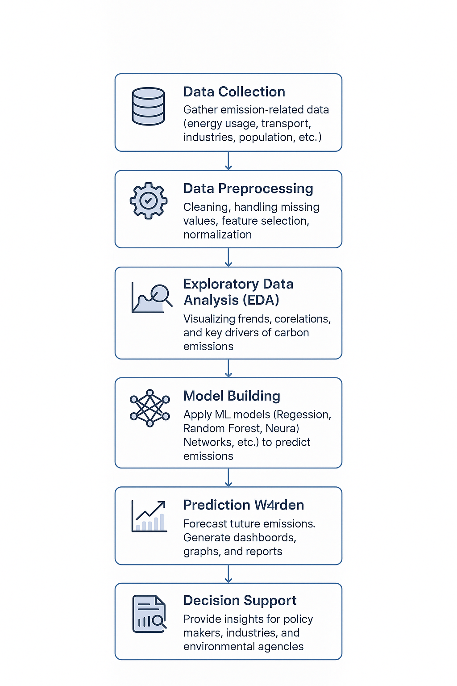
Modelling/Block Diagram/Flow of Project
Notes:
Sustainability and AI
Sustainability is important because it helps meet our needs now and in the future. It includes protecting the environment, reducing pollution, and improving economic and social well-being.
AI can help us achieve sustainability. AI can process data, make predictions, and optimize systems to solve problems like resource management, environmental conservation, and energy efficiency.
Examples:
Smart grids: Reduce energy consumption.
Agriculture: Optimize water and fertilizer use.
Biodiversity: Monitor wildlife to protect biodiversity.
AI is a powerful tool for creating a more sustainable future.

Slide 8
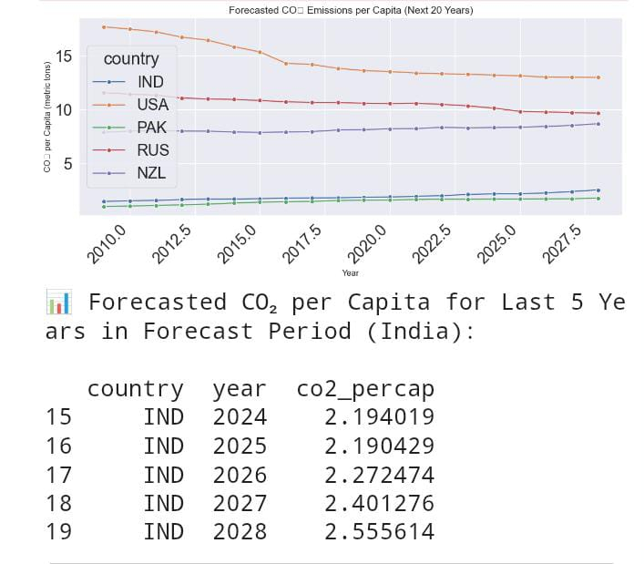
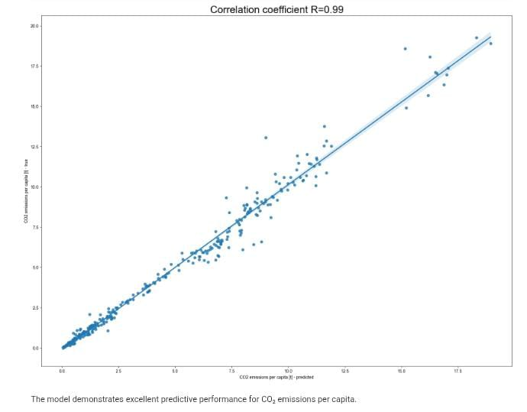
Result/Outcomes
Notes:
Sustainability and AI
Sustainability is important because it helps meet our needs now and in the future. It includes protecting the environment, reducing pollution, and improving economic and social well-being.
AI can help us achieve sustainability. AI can process data, make predictions, and optimize systems to solve problems like resource management, environmental conservation, and energy efficiency.
Examples:
Smart grids: Reduce energy consumption.
Agriculture: Optimize water and fertilizer use.
Biodiversity: Monitor wildlife to protect biodiversity.
AI is a powerful tool for creating a more sustainable future.

Slide 9
Conclusion
The project shows that carbon emissions can be reliably predicted using socio-economic and environmental factors. Key drivers include energy use, GNI per capita, cereal yield, protected areas, and urban growth. The model offers insights to support sustainable policies and future improvements can focus on time-series and deep learning approaches.
Notes:
Sustainability and AI
Sustainability is important because it helps meet our needs now and in the future. It includes protecting the environment, reducing pollution, and improving economic and social well-being.
AI can help us achieve sustainability. AI can process data, make predictions, and optimize systems to solve problems like resource management, environmental conservation, and energy efficiency.
Examples:
Smart grids: Reduce energy consumption.
Agriculture: Optimize water and fertilizer use.
Biodiversity: Monitor wildlife to protect biodiversity.
AI is a powerful tool for creating a more sustainable future.

Slide 10
Future Perspective
Integrating time-series forecasting for long-term emission trends.
Applying advanced models like deep learning and ensemble methods.
Expanding datasets with real-time and regional data.
Supporting policy simulations to evaluate climate strategies.
Notes:
Sustainability and AI
Sustainability is important because it helps meet our needs now and in the future. It includes protecting the environment, reducing pollution, and improving economic and social well-being.
AI can help us achieve sustainability. AI can process data, make predictions, and optimize systems to solve problems like resource management, environmental conservation, and energy efficiency.
Examples:
Smart grids: Reduce energy consumption.
Agriculture: Optimize water and fertilizer use.
Biodiversity: Monitor wildlife to protect biodiversity.
AI is a powerful tool for creating a more sustainable future.

Slide 11
Thank You
Notes:
Thank You !!

